Slide 1
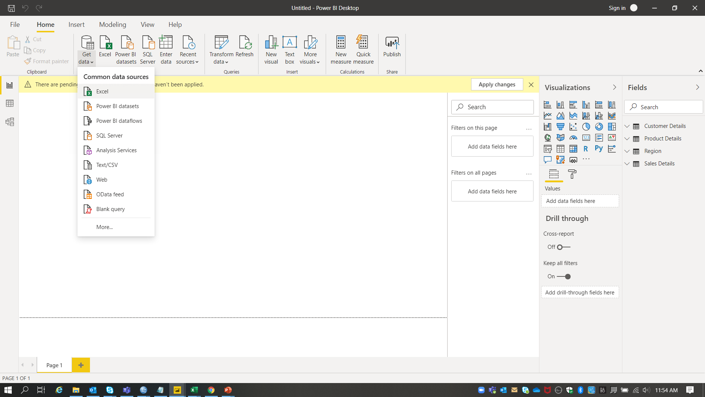
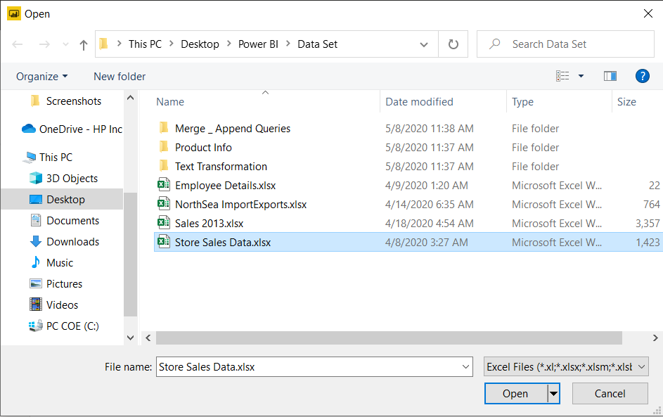
1. I. Connect to the Store Sales Data and do the following: -
Steps to connect to the data.
Home page -> Get Data -> Excel -> Select the required file -> Open

Slide 2
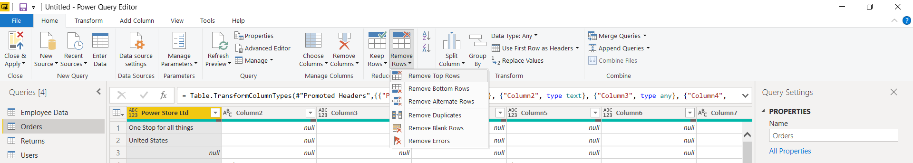
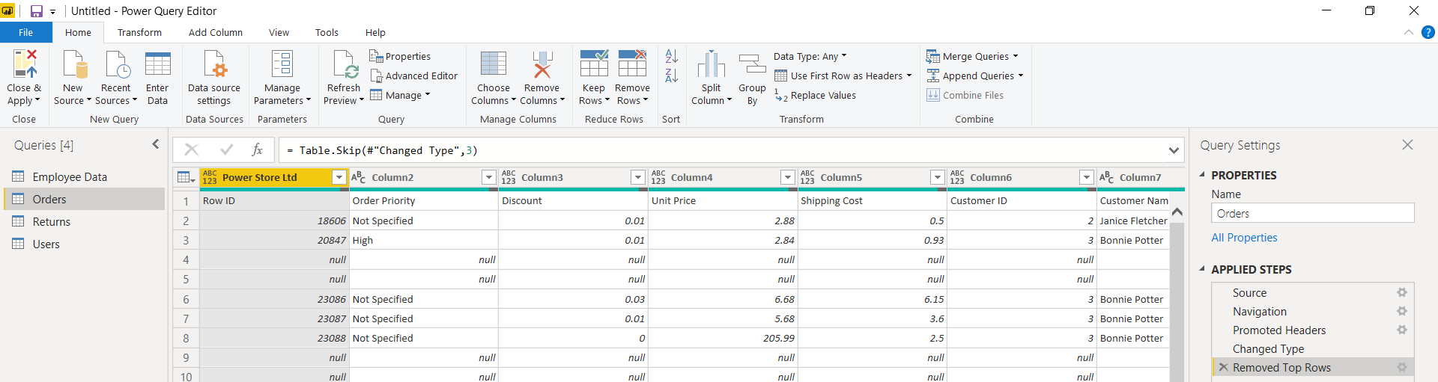
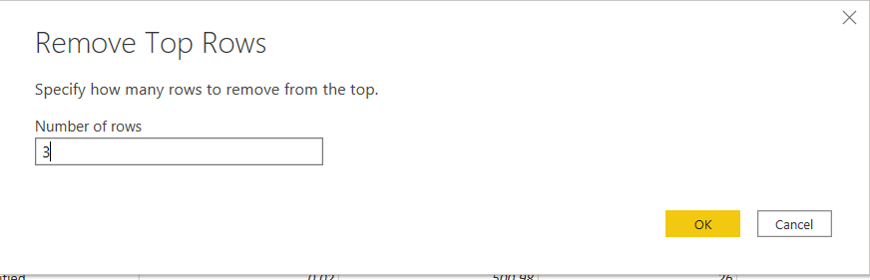
Remove all the blank rows
Steps to remove the blank rows in Power query editor
Home Tab -> Remove Rows -> Remove Top Rows
Enter 3 in Number of rows as the first three rows has null values -> OK
Output post removal of rows

Slide 3
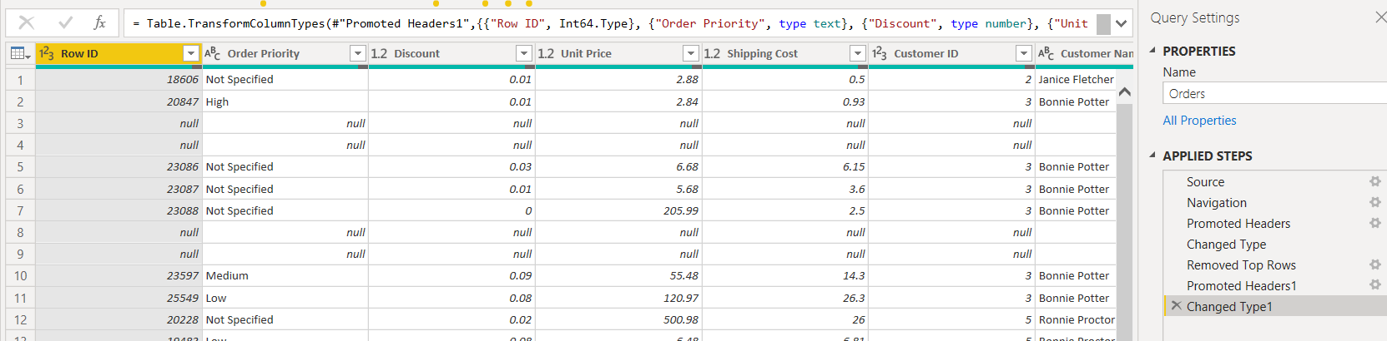
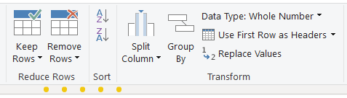
II . Update the column header if they are not updated
Step to use first row as header column
Home -> Use first row as header
Output post using first row as header

Slide 4
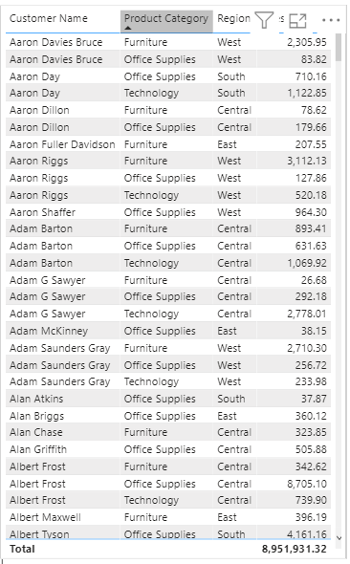
III . Create a text table and show the sales in terms of - Customers - Product Category – Regions
Steps
Visualization -> Table ->
Drag
Customer Name
Product Category
Region
Sales
to Values filed.

Slide 5
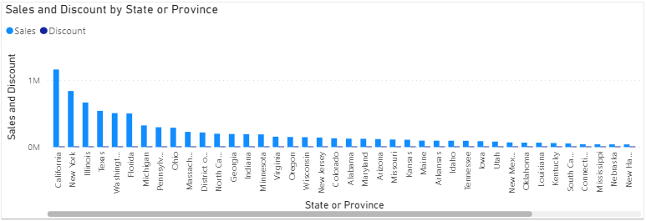
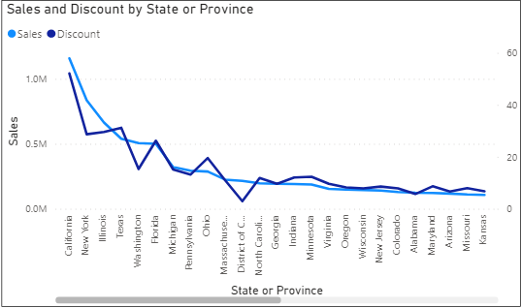
2. I. Create a line and Clustered Column Chart showing the Sales and Discount as per the State or Province
Step
Visualization -> Clustered Column Chart ->
Drag ‘State or Province’ to Axis, ‘Sales & Discount’ to values
Visualization -> Line Chart ->
Drag ‘State or Province’ to Axis, ‘Sales’ to Values & ‘Discount’ to Y2

Slide 6
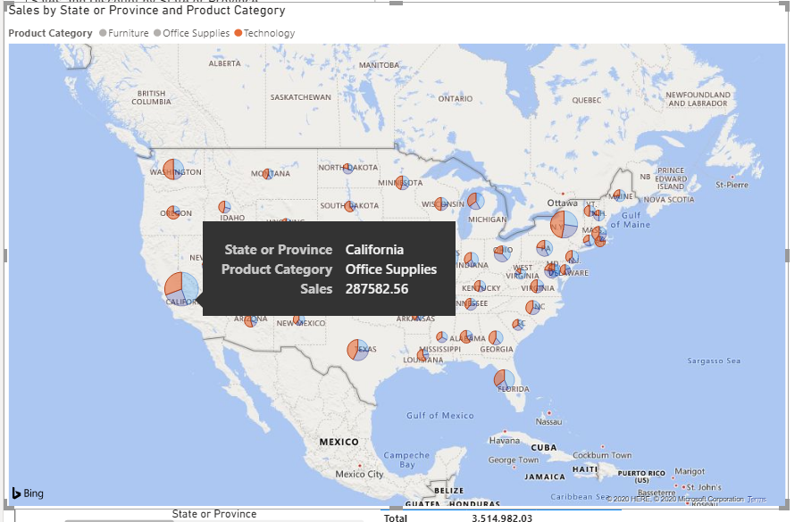
II. Which state has the highest sales in terms Technology
Step
Visualization -> Map ->
Drag ‘State or Province’ to Location, ‘Product Category’ to Legend & ‘Sales’ to Size
California has the highest sales in Technology.

Slide 7
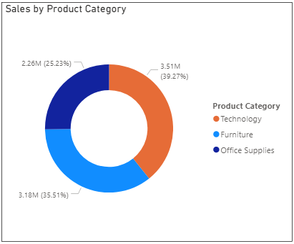
3. Create a Donut Chart showing sales in terms of Product category
Step
Visualization -> Clustered Column Chart ->
Drag ‘Product Category’ to Legend, ‘Sales’ to values

Slide 8
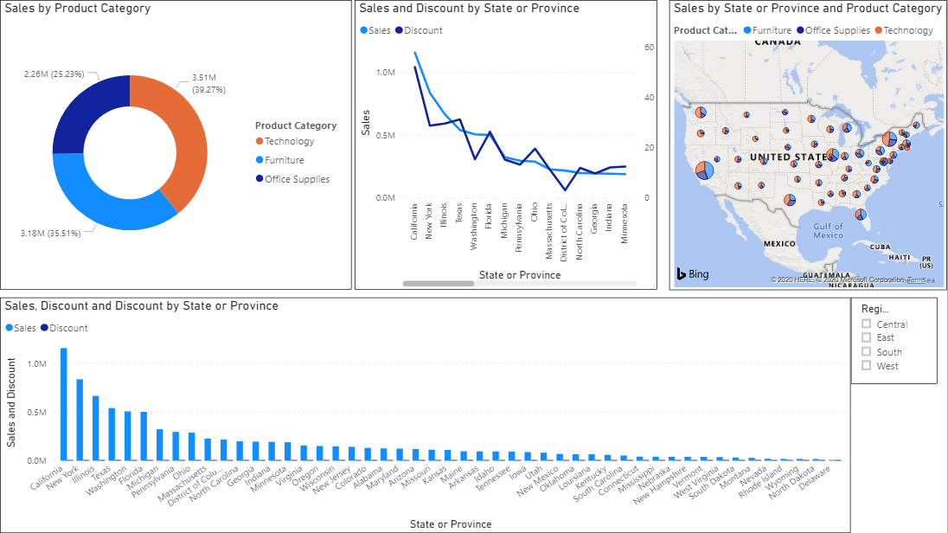
4. Create a Slicer and show the regions in dropdown. See how all the visuals mentioned above behaving when a particular region is selected.
Overall dashboard

Slide 9
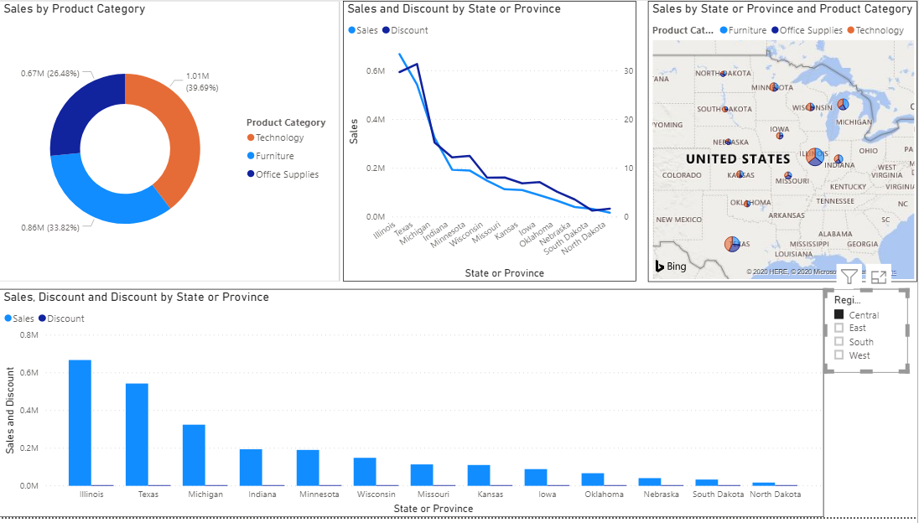
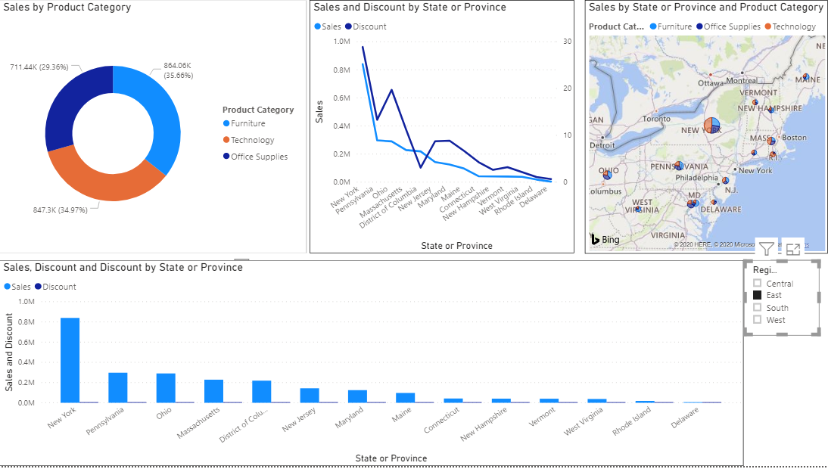
Central Region
East Region

Slide 10
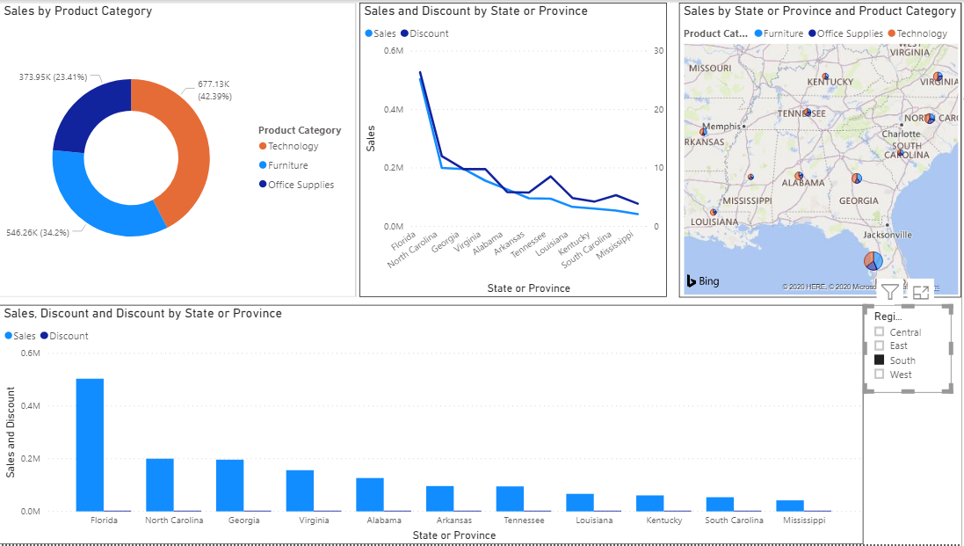
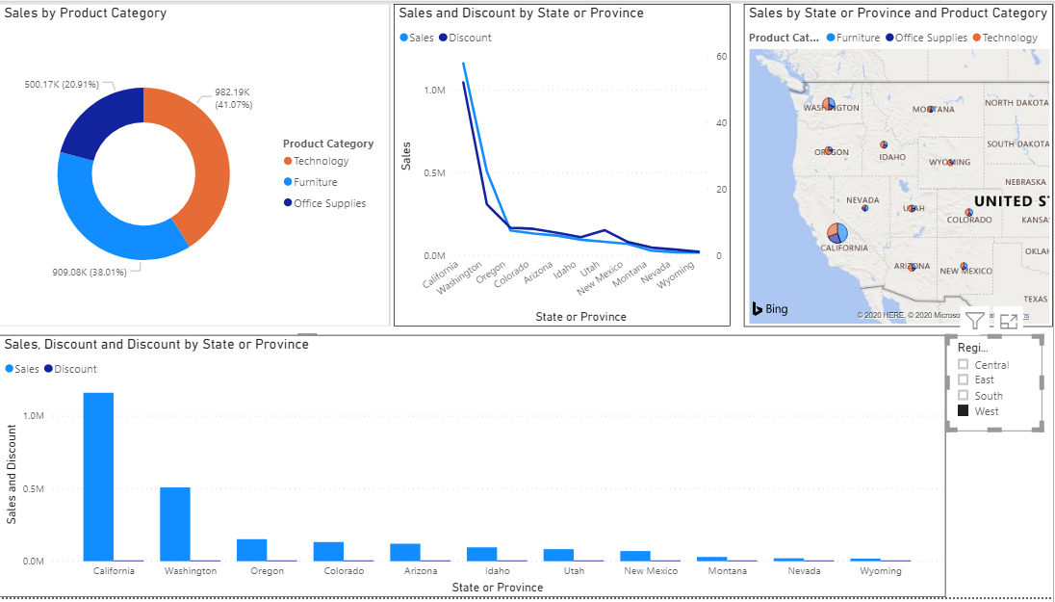
South Region
West Region

